Slide 1
PRO2000 - programming
Week 41- Embedded C++ Programming
Gebremariam Assres
Gebremariam.assres@kristiania.no

Slide 2
Today's topics
Embedded Programming and Microcontrollers
Arduino
Coding in Arduino IDE
Coding in C++

Slide 3
Embedded Programming
Embedded programming is the process of writing software, often called firmware, to control specialized hardware devices.
Characteristics: special purpose, resource limited, direct hardware control, real-time demands
Platforms/microcontrollers: like ATmega328P of Arduino Uno, STM32, ESP32, etc.
Languages: Low/mid-level languages like C, C++ and Assembly.

Slide 4
Arduino
Arduino is the go-to gear for artists, hobbyists, students, and anyone with a gadgetry dream.
Arduino rose out of another formidable challenge: how to teach students to create electronics, fast.
With Arduino, you can control almost everything around you be it simple LED or giant Robots.

Slide 5
Arduino
Basically Arduino is Microcontroller.
Microcontroller is microprocessor with memory, RAM and some other peripheral connected with it.
The Arduino Uno is a microcontroller board based on the ATmega328 . The ATmega328 has Flash memory of 32 KB (with 0.5 KB used for the bootloader). It also has 2 KB of SRAM and 1 KB of EEPROM
Notes:
Flash- Where program is stored.
SRAM-Static Random Access Memory ( sketch creates and manipulates variables when it runs )
EEPROM- Electrically Erasable Programmable Read-Only Memory ( memory whose values are kept when the board is turned off )

Slide 6
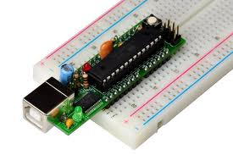
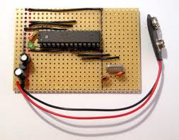
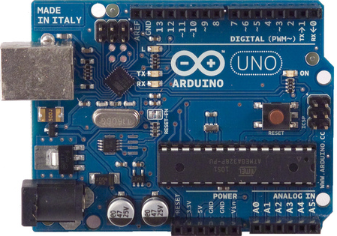
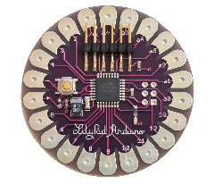
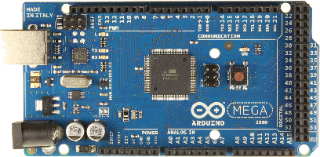
Different types of Arduino
Boarduino Kit
DIY Arduino
Arduino LilyPad
Arduino Uno
Arduino Mega 2560

Slide 7
Arduino uno
What does it have?
  14 Digital In/Out pins (6 can be used as PWM)
  6 Analog Inputs
  A USB Connection
  A Power Jack
  Reset Button
  On-board LED
  SCL/SDA pins (Serial Clock/ Serial Data pins)
In short, it contains everything needed to support the microcontroller; simply connect it to a computer with a USB cable or power it with a AC-to-DC adapter or battery to get started.

Slide 8
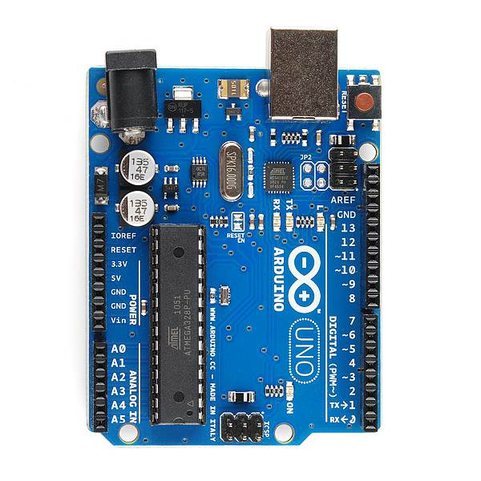
USB
(to Computer)
PWR IN
RESET
SCL\SDA
(I2C Bus)
POWER
5V / 3.3V / GND
Digital I\O
PWM(3, 5, 6, 9, 10, 11)
Analog INPUTS

Slide 9
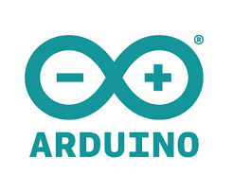
How to code in Arduino
You need to download Arduino IDE (Integrated Development Environment).
Arduino IDE is available for all Mac, Windows, and Linux.

Slide 10
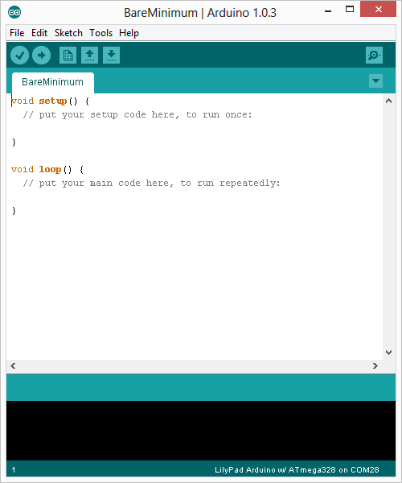
How to code in Arduino …
Once you have downloaded and installed/extracted the folder, you can directly run Arduino.exe, which will take you to its IDE.
The IDE will look like the shown screenshot.
error & status messages

Slide 11
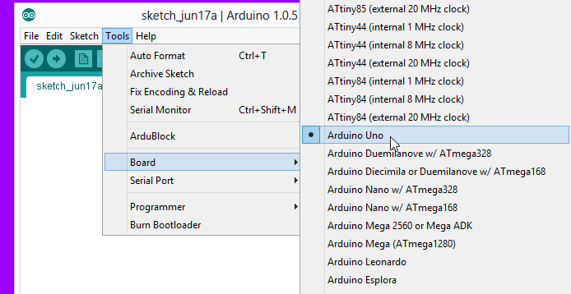
Program your Arduino
Before you start programming, double check that correct board is selected under Tools → Board.
Now, you can start playing with Arduino.

Slide 12
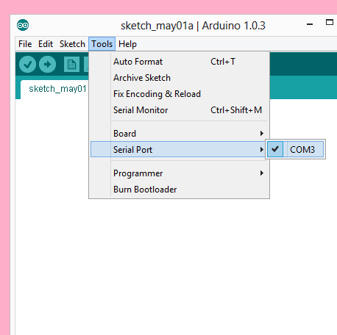
Program your Arduino
The Arduino Uno can be programmed with the Arduino software. Select "Arduino Uno from the Tools > Board menu (according to the microcontroller on your board).
All the peripheral connected with Computers are using Serial Port.
You can check port for Arduino Uno in Device Manger.

Slide 13
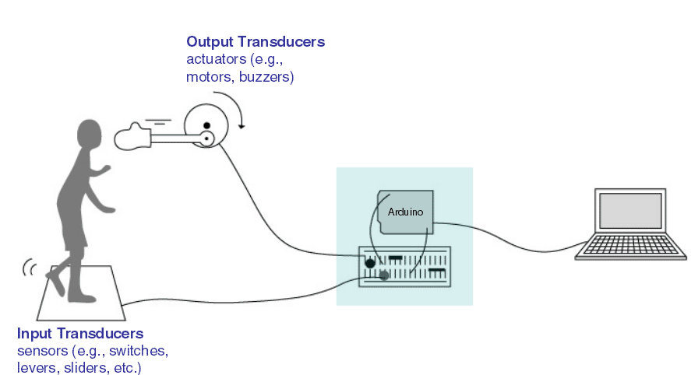
Input vs output
Image from Theory and Practice of Tangible User Interfaces at UC Berkley

Slide 14
6 Major concepts
digitalWrite()
analogWrite()
digitalRead()
If (statements) / Boolean
analogRead
Serial Communication

Slide 15
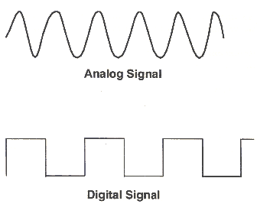
Analog vs digital
Microcontrollers are digital devices – ON or OFF. Also called – discrete.
Analog signals are anything that can be a full range of values.
5 V
5 V
0 V
0 V

Slide 16
Analog vs digital
Analog Sensors
Digital Sensors
  Digital sensors are more straight forward than Analog.
  No matter what the sensor there are only two settings: On and Off
Example, Push button, Switch
Sensors | Variables
Mic | soundVolume
Photoresistor | lightLevel
Potentiometer | dialPosition
Temp Sensor | temperature
Flex Sensor | bend
Accelerometer | tilt/acceleration

Slide 17
Serial communication
“Serial” because data is broken into bits, each sent one after another in a single wire.
Compiling turns your program into binary data (ones and zeros)
Uploading sends the bits through USB cable to the Arduino
The two LEDs near the USB connector blink when data is transmitted.
  RX blinks when the Arduino is receiving data.
  TX blinks when the Arduino is transmitting data

Slide 18
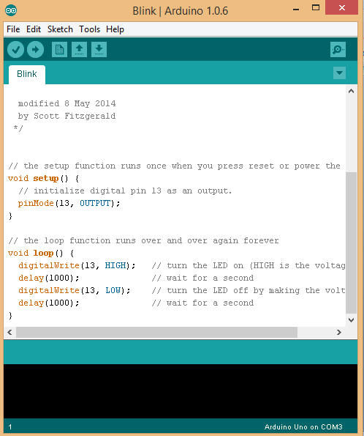
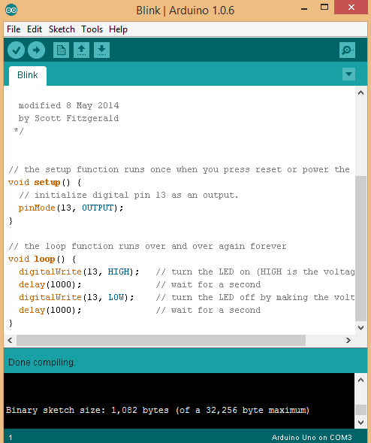
Project #1 led blink digitalWrite()
Upload
Compile
https://docs.arduino.cc/language-reference/en/functions/digital-io/digitalwrite/
Status Message

Slide 19
How to code in C++
Embedded programming in C++ allows to write clean, object-oriented, type-safe code without adding runtime or memory overhead.
In resource constrained environments, C++ uses compile time computations like constexpr, and strict type like enum.
Let’s target the ATmega328P microcontroller of Arduino Uno.

Slide 20
How to code in C++ …
Embedded C++ example to blink the built-in LED (Pin 13) on an Arduino Uno.
On the Uno, digital Pin 13 corresponds to Port B, Pin 5.
We manipulate it using three hardware registers: DDRB (Direction), PORTB (Data Output), and PINB (Input/Toggle).

Slide 21
How to code in C++ …
Libraries- AVR delay utility
  #include <stdint.h>
  #include <util/delay.h>
Strongly typed enum for safety
  enum class PinState : uint8_t { Low = 0, High = 1};
Hardware mapping for ATmega328P Port B
  struct PortB_Registers {
  volatile uint8_t PIN; // Input Pins Address (0x23)
  volatile uint8_t DDR; // Data Direction Register (0x24)
  volatile uint8_t PORT; // Data Register (0x25)
  };
Notes:
In the context of the Arduino Uno, you likely mean AVR, which is the architecture of the microcontroller chip (ATmega328P) that powers the board.
AVR is an abbreviation for Alf and Vegard's RISC processor.
Here is the exact breakdown of the abbreviation:
Alf – Alf-Egil Bogen (Co-inventor)
Vegard – Vegard Wollan (Co-inventor)
RISC – Reduced Instruction Set Computer (The type of hardware design)

Slide 22
How to code in C++ …
Zero-Overhead C++ Driver Class
public:
// Standard constructor
constexpr UnoLed() = default;
// Configure Port B Pin 5 as an Output
void init() {
regs()->DDR |= LED_PIN_MASK;
}
// Set LED explicitly On or Off
void write(PinState state) {
if (state == PinState::High) {
regs()->PORT |= LED_PIN_MASK; // Set bit high
} else {
regs()->PORT &= ~LED_PIN_MASK; // Clear bit low
}
}
// Hardware-accelerated toggle (Writing a '1' to the PIN register toggles an AVR output pin instantly)
void toggle() {
regs()->PIN = LED_PIN_MASK;
}
};
class UnoLed {
private:
// Base address for Port B registers on ATmega328P
static constexpr uintptr_t PORTB_BASE = 0x23;
// Hardcoded bitmask for Pin 13 (Bit 5 of Port B)
static constexpr uint8_t LED_PIN_MASK = (1 << 5);
// Cast the raw memory address to our register structure
inline PortB_Registers* regs() const {
return reinterpret_cast<PortB_Registers*>(PORTB_BASE);
}

Slide 23
How to code in C++ …
Main Application Entry Point
int main() {
UnoLed led;
led.init(); // Setup Pin 13 as output
while (true) {
// Method A: Explicit On/Off using Enums
led.write(PinState::High);
_delay_ms(500); // 500 millisecond delay
led.write(PinState::Low);
_delay_ms(500);
// Method B: Ultra-fast toggle alternative
// led.toggle();
// _delay_ms(500);
}
return 0;
}
In C++, it completely replaces the Arduino setup() and loop() structure with a standard C++ main() loop,
  It saves valuable flash memory on framework initializations.
To compile and run:
  Download, install, and configure the Arduino IDE
  Write C++ code
  Load→ Observe by changing the arguments of the delay function.

Slide 24
How to code in C++ …
Automate it in VS Code (tasks.json)
{
"version": "2.0.0",
"tasks": [
{
"label": "Build and Flash Uno",
"type": "shell",
"command": "avr-g++ -c -g -Os -Wall -fno-exceptions -ffunction-sections -fdata-sections -mmcu=atmega328p -DF_CPU=16000000L main.cpp -o main.o
&& avr-g++ -g -Wall -Os -mmcu=atmega328p -Wl,--gc-sections main.o -o main.elf
&& avr-objcopy -O ihex -R .eeprom main.elf main.hex
&& avrdude -F -V -c arduino -p m328p -P COM3 -b 115200 -U flash:w:main.hex:i",
"group": {
"kind": "build",
"isDefault": true
},
"problemMatcher": []
}
]
}
https://docs.arduino.cc/learn/electronics/lcd-displays/#custom-character

Slide 25
Up next: Exercises
Now: 2 hours (12:15 to 14:00) of exercises (found on Canvas).
Short exercise summary:
  Write, compile, and debug embedded programs with emphasis on Arduino IDE and C++ with VS Code.
Remember:
  You should do approximately 4 more hours of the course (in a study group or alone) before our next session together. :-)

